Slide 1
Ticket Price Analysis
Does Big Mountain Resort ticket prices reflect the size and amount of facilities provided?
What facilities provide value to the ticket price and what facilities could be cut without harming the value?

Slide 2
Recommended Price and Facility changes
Recommended Price: 87.00
Predicted ticket range: $95.87 +/- $10.39
With the projected ticket range between $85.48 - $106.26, we’ve set the recommended price toward the lower end as the regional competition ticket prices are far lower and the possibility of losing local visitors from raising prices has not been analyzed.
Recommended option of Scenarios provided: Scenario 2
Adding a run that extends the vertical drop 150 feet and adding a chair lift will produce the best support for ticket price increase and add the lowest amount of maintenance costs.
Most significant attributes that correlate to ticket price:
Fast Quads, Runs, Snow Making AC, and Vertical Drop

Slide 3
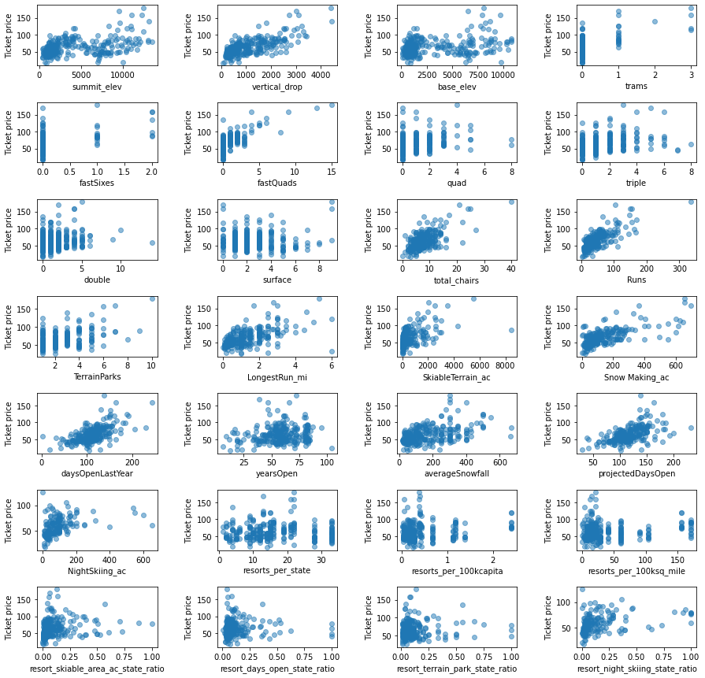
Data Variables Correlation to Ticket Price

Slide 4
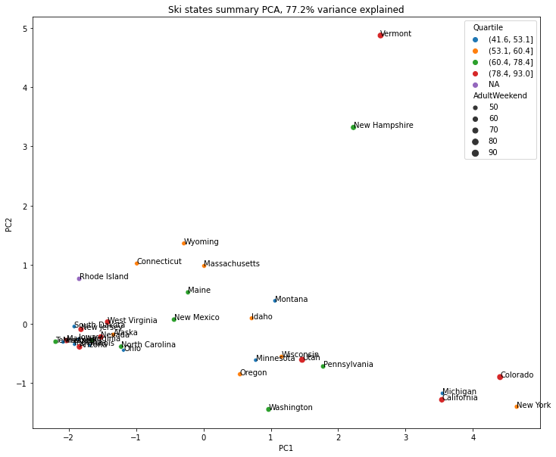
NO correlation seen between Price and Location

Slide 5
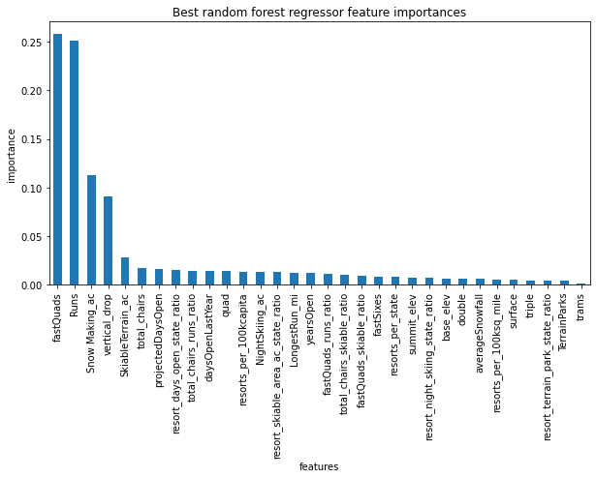
Variable significance in Determining Price

Slide 6
Summary
After analyzing the resort data using both linear regression and random forest regression models, the data gave us a reliable random forest model with an MAE average of 10.39 and low variability of 1.47 checked using cross validation. This recommendation of $87 is at the low end of our range but $6 more than the current price of $81. With visitor data, we may be able to determine our biggest competition and may show potential for a price increase. This initial price increase should improve revenue by $10.5 million.
If the resort was to upgrade the facilities by scenario #2, this would support the increase of ticket prices by $1.99. This would produce another $1.96 million in revenue after subtracting the additional chair lift maintenance costs.

